Slide 1
BIKE SHARING ANALYSIS
GROUP 9
BY:
PRECIOUS NWORIE
MARIA KOKO
OGUNDIPE AYOMIDE
IDEMUDIA FAITH
ADEWUNMI SHERIFAT
OLAWUYI IMOLEAYO

Slide 2
INTRODUCTION
This analysis shows the rate at which bikes were shared/rented with respect to the type of users, seasons, weather, holidays and weekdays.

Slide 3
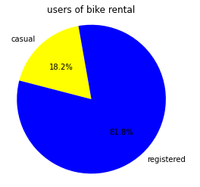
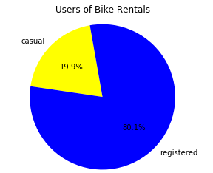
BIKE USERS IN 2011/2012
YEAR 2012
YEAR 2011

Slide 4
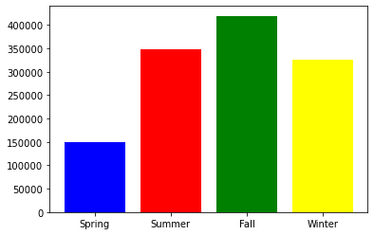
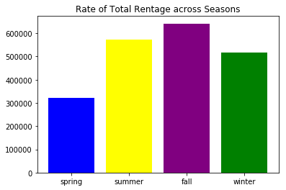
TOTAL BIKE SHARED IN 2011/2012 PER SEASON
YEAR 2011
YEAR 2012

Slide 5
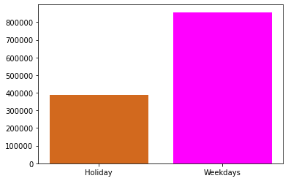
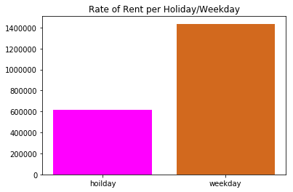
TOTAL BIKE SHARED IN 2011/2012 PER HOLIDAY/WEEKDAY
YEAR 2011
YEAR 2012

Slide 6
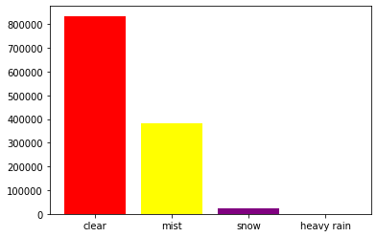
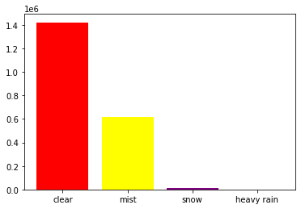
TOTAL BIKE SHARED IN 2011/2012 PER WEATHER
YEAR 2011
YEAR 2012

Slide 7
INSIGHTS DERIVED
From the pie chart, the casual bike sharing reduced from 19.9% to 18.8%, which in turn resulted to an increase in the registered users.
In the year 2011 & 2012, fall had the highest number of users (both casual and registered)
More bikes were shared/rented on weekdays compared to the holidays in both years 2011 & 2012.
Whenever the weather is clear, more bikes were rented out.

